Slide 1
Modelling the Effect of Monetary and Fiscal Policy on Housing Price in Germany 2000-2020
Mohamadreza Sabaghian

Slide 2
Macroeconomics and Housing Market
Why Housing ?
Psychological Importance for People (need for schelter)
Big Impact on Economy, Governments and People
Why Modelling ?
Planning (control) and Prediction (simulation)
Notes:
The need for a shelter is one of the most fundamental needs from Malsow‘s Pyramid
The psychological and economical impact of housing on people economy is undeniable
Therefor, housing sector is a major area of interest for both governments and people
In order to be able to predict or control this market we need to understand and model this sector of economy
5) In This work examine the impact of a range of sector-specific and macroeconomic shocks on the German housing market

Slide 3
Macroeconomics and Housing Market
Chosen Approaches:
Monetary Transition Channels (Analytic)
Model Identification from Data (Computational Macroeconomics)
Notes:
In this work, we firstly examine an existing well known model in this area with the real data from German economy.
Secondly, identify a model from data to get a better understanding of the system.

Slide 4
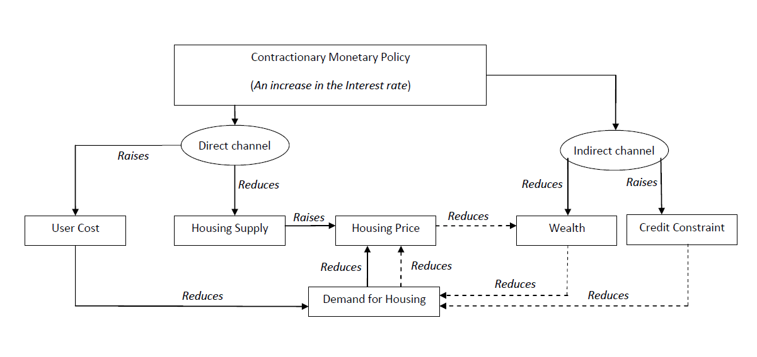
Transition Channels
Source: Wadud 2009
Notes:
Standard approach for macroeconomics is the IS-LM .
A two-dimensional macroeconomic tool that shows the relationship between interest rates and assets market (also known as real output in goods and services market plus money market).
2)Mishkin (1996) provides a comprehensive analytical framework on how the effects of
monetary policy are transmitted through various channels. Has ISLM model in its heart.
1) direct effects of monetary policy is transmitted on to the user cost on housing,
short-term rate, long-term rate also tends to rise driven by expectations of future
increase in the short-term rate; and hence, the average mortgage rate also raises leading to
higher user cost of capital on housing
defined as an opportunity cost of occupying a house rather than renting. If the opportunity
cost of owning a house is lower than renting, demand for housing activities is likely to
decline.
2) From the supply side perspective, any increase in short term interest rate may have an
immediate impact on housing construction cost, thereby housing output.
3) It is understandable that the fall in real house prices due to lower demand for housing as a
result of contractionary monetary policy will lead to a decline in asset (wealth) for
Individuals
4) Households might be credit constrained whose expenditure exceeds their revenue. reduces their cash. Th Higher nominal rates, , reduce current cash flow due to increase in mortgage rate will lower after interest and tax income.
From credit channel perspective,
5) due to asymmetric information between
potential house buyer and financial institution Lenders are reluctant to make
loans because they have difficulties identifying the credit worthiness of the borrower.

Slide 5
Macroeconomics Data
Interest Rate (r)
Money Market Interest Rate (EONIA)
ECB’s Deposit Facility Rate + ECB Interest Rates for Main Refinancing Operation
Yearly Averaged
Source: Bundesbank Timeseries
Goverment Spending (rg)
General Government Deficit (+) or Surplus (-) as Defined in the Maastricht Treaty
Percentage of Yearly Change
Source: Bundesbank Timeseries
Notes:
r is the money market interest rate (EONIA) rate at which banks provide loans to each other with a duration of 1 day, In my opinion this is a good indicator of the monetary policy since it combines central banks ECB's deposit facility rate and s. This affect is more clear when we look in the recent data after 2018 where central banks interest rate for refinancing is zero but the deposit facility goes negative and this stimulates banks to lend more money. Original data is monthly and we need to average to get the yearly rate. See https://www.Bundesbank
Eonia is short for Euro Over Night Index Average. The Eonia rate is the 1-day interbank interest rate for the Euro zone. In other words, it is the rate at which banks provide loans to each other with a duration of 1 day..de/en/statistics/time-series-databases
2) General government deficit(-) or surplus(+) as defined in the Maastricht Treaty from Bundes Bank is used, In my opinion it is a good indicator of the Government fiscal policy since it includes both expenditure and earinging of the gorvernment. Change in percentage for each year is calculated and sign is reversed such that when the governemnt has a deficit it is an indicator if positive government spending.

Slide 6
Housing Market Data
Real House Price (hp)
Ratio of Nominal Price to the Consumers’ Expenditure Deflator
Normalized (2015 = 100)
Inflation and Seasonal Changes
Source: OECD 2020
Material Cost (mc)
Percentage of Change Construction Price Index
Source: Bundesbank 2020
Notes:
1) The real house price is given by the ratio of nominal price to the consumers’ expenditure deflator in each country, both seasonally adjusted, from the OECD national accounts database.

Slide 7
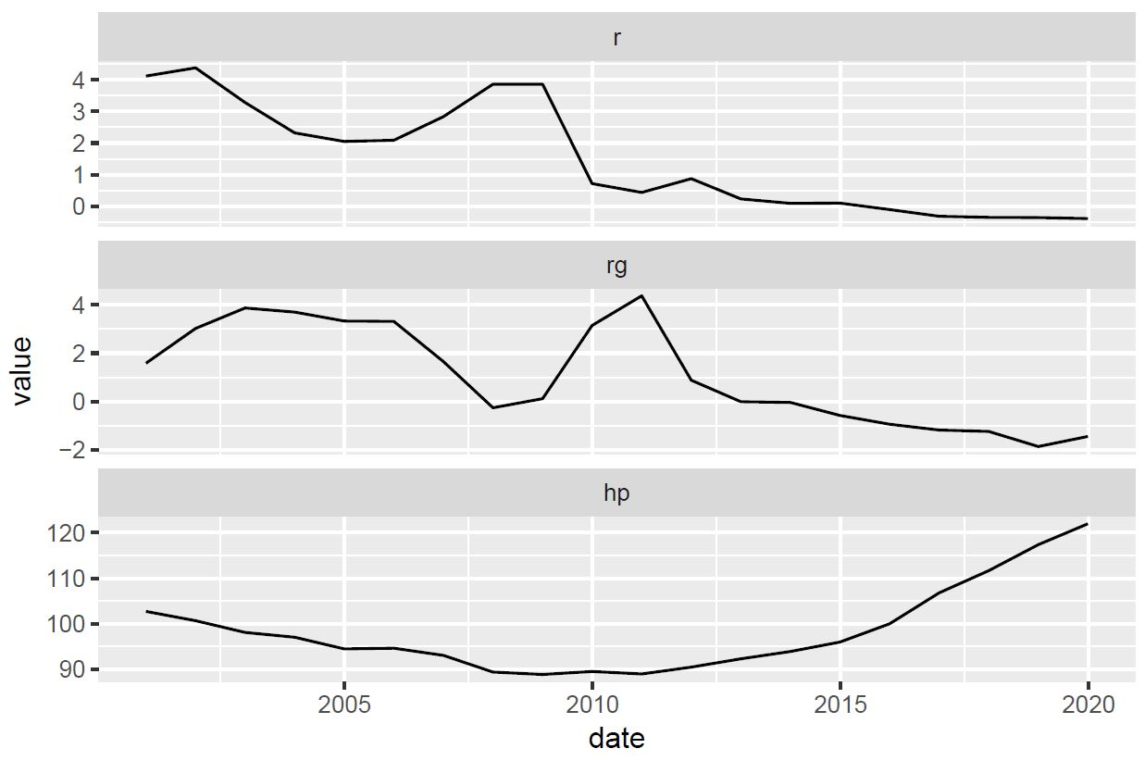
Interest Rate and Government Spending vs House Price
Notes:
Very sticky price look at how when governmetn reduces spending house price increase! Memorize this!

Slide 8
Supply and GDP Data
Housing Supply (h)
Number of Completed New Dwelling in West Germany in Thousand
Source: Statista 2020
Gross Domestic Product (ry)
Price Adjusted
Normalized (2015 = 100)
Source: Bundesbank 2020
Notes:
1) west germany is used as trend is the same in east! this is the only free source of data I could find for this period.
in thousenad number-completed-new-dwellings-west-germany/ in thousenad
2)

Slide 9
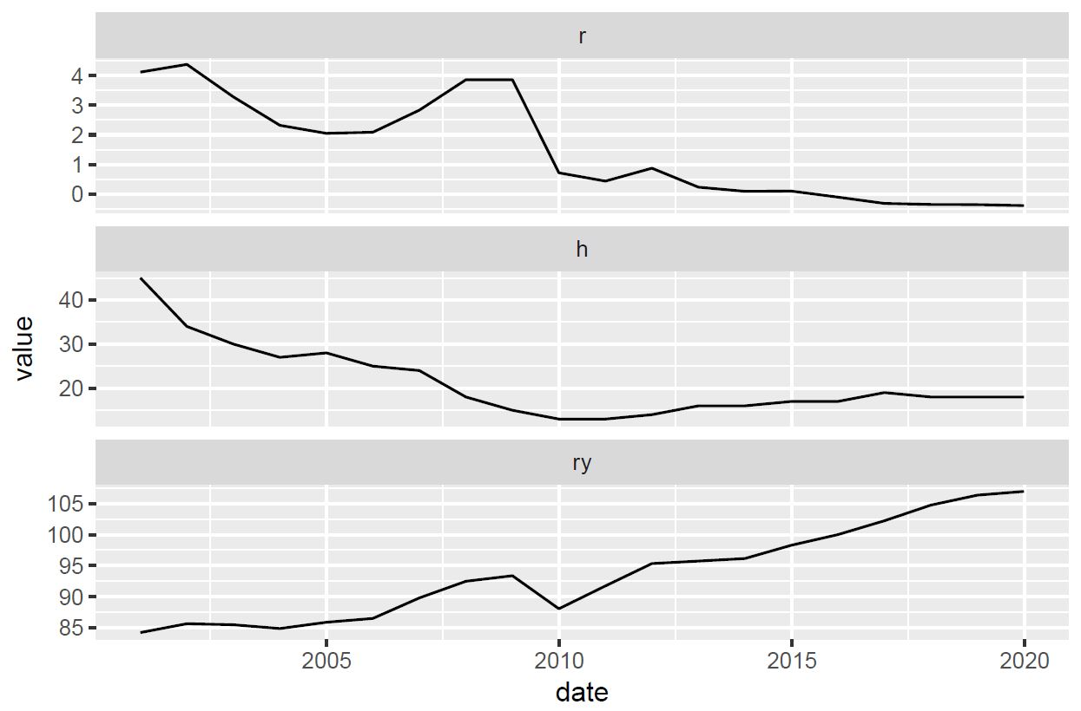


Interest Rate vs Housing Suppy and GDP
Notes:
Decrease interest rate – increase in supply and output

Slide 10

SVAR Identification
SVAR Model:
$A_{0} y\left(t\right)={µ+ A}_{1} y\left(t−1\right)+ …+ A_{l} y(t−l)$ + $B_{0} ℇ(t)$
Where:
$$y=\left[ log\left(h\right), log\left(hp\right), mc, rg, r, log\left(ry\right)\right]$$
$A_{0}= identity matrix$
$$l=2$$
Notes:
1) is a stochastic process model used to capture the linear interdependencies among multiple time series
The error terms$\epsilon_t$ (structural schocks) is an n-vector of serially uncorrelated zero mean structural schocks. matrix.
2) All variables in a VAR enter the model in the same way: each variable has an equation explaining its evolution based on its own lagged values, the lagged values of the other model variables, and an error term
3) The vector ut consists of reducedform residuals, which are serially uncorrelated with E(ut) = 0 and Cov(ut) = Σu. The nonsingular matrix B captures the instantaneous effects of the structural shocks εt = B−1ut on the variables of the system
The second challenge is that the number of parameters to be identified in the structural model is larger than that of the reduced VAR form. Therefore, some new relations needs to be introduced. This can be usually done by introducing restrictions on $A_0$ or $B_0$

Slide 11

Identification in R

Slide 12
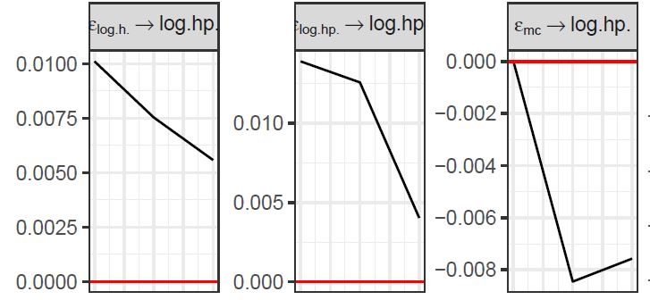
Impulse Response on Housing Price
Increase in supply reduces the price
Material cost has very small effect on housing price
Notes:
Looking in material cost data it decreses 2011 to 2015 but house price increses sharply

Slide 13
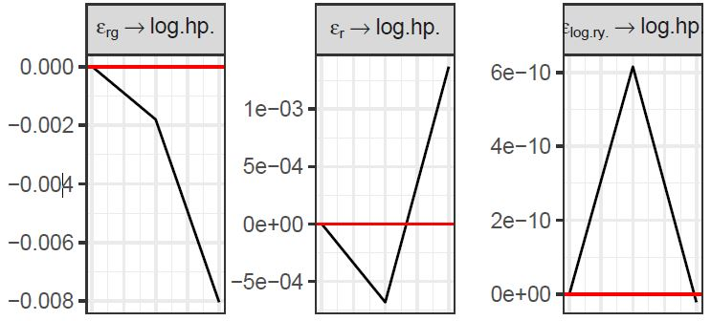
Impulse Response on Housing Price
Increase in governemnt spending reduces the price!
Interest rate increase reduces the price
Increase in GDP increases the price
Notes:
Very sticky house price we identified only with 2 years!

Slide 14
Future Work
Richer Data (e.g. from nonkeynesian economics)
Data Analysis before Identification for Lag and Parameters Selection
Additional Constraints on the Model
Certainty Evaluation of the Results

Slide 15
Q & A
“If all the economists were laid end to end, they'd never reach a conclusion.” George Bernard Shaw

Slide 16
References
Bundesbank (2020) doi: https://www.bundesbank.de/en/statistics/time-series-databases (Accessed on 18 May 2020)
OECD (2020), Housing prices (indicator). doi: 10.1787/63008438-en (Accessed on 18 May 2020)
Statista (2020) .doi: https://www.statista.com/statistics/999254/number-completed-new-dwellings-west-germany/ (Accessed on 18 May 2020)
Mishkin, Frederic S. (1996): The Channels of Monetary Transmission: Lessons for Monetary Policy, NBER Working Papers 5464, s.I.: National Bureau of Economic Research,
Mishkin, Frederic (2007): Housing and the Monetary Transmission Mechanism, in: Finance and Economics Discussion Series, 2007 (2007), pp. 1–53
Wadud, I.K.M., Bashar, Omar, ali ahmed huson joher, huson joher (2009): An SVAR Analysis of Monetary Policy Dynamics and Housing Market Responses in Australia, in:
Deakin University, Faculty of Business and Law, School of Accounting, Economics and Finance, Economics Series (2009)
Lange2020 Lange, Alexander, Dalheimer, Bernhard, Herwartz, Helmut, Maxand, Simone (forthcoming): svars: An R Package for Data-Driven Identification in Multivariate Time Series Analysis, in: Journal of Statistical Software (forthcoming)

